Slide 1

Load Balancing
Presented by:
Saurabh Singhal
Assistant Professor

Slide 2
Load balancing
Load balancing in the cloud allows data centers to avoid overloading/underloading in virtual machines, which itself is a challenge in the field of cloud computing.
Load balancing provides the facility to distribute the workload equally on available resources.

Slide 3
Load balancing
Load Balancing objective is:
To provide continuous service in case of failure of any service’s component
Aims to minimize the response time for tasks and improve resource utilization,
Aims to provide scalability and flexibility
Reducing energy consumption and carbon emission
Avoiding bottlenecks
Resource provisioning and fulfilling QoS requirements for improving load balancing.

Slide 4
CHALLENGES IN LOAD BALANCING
Geographical Distributed Nodes
Single Point of Failure
Virtual Machine Migration
Heterogeneous Nodes
Storage Management
Load-Balancer Scalability
Algorithm Complexity

Slide 5
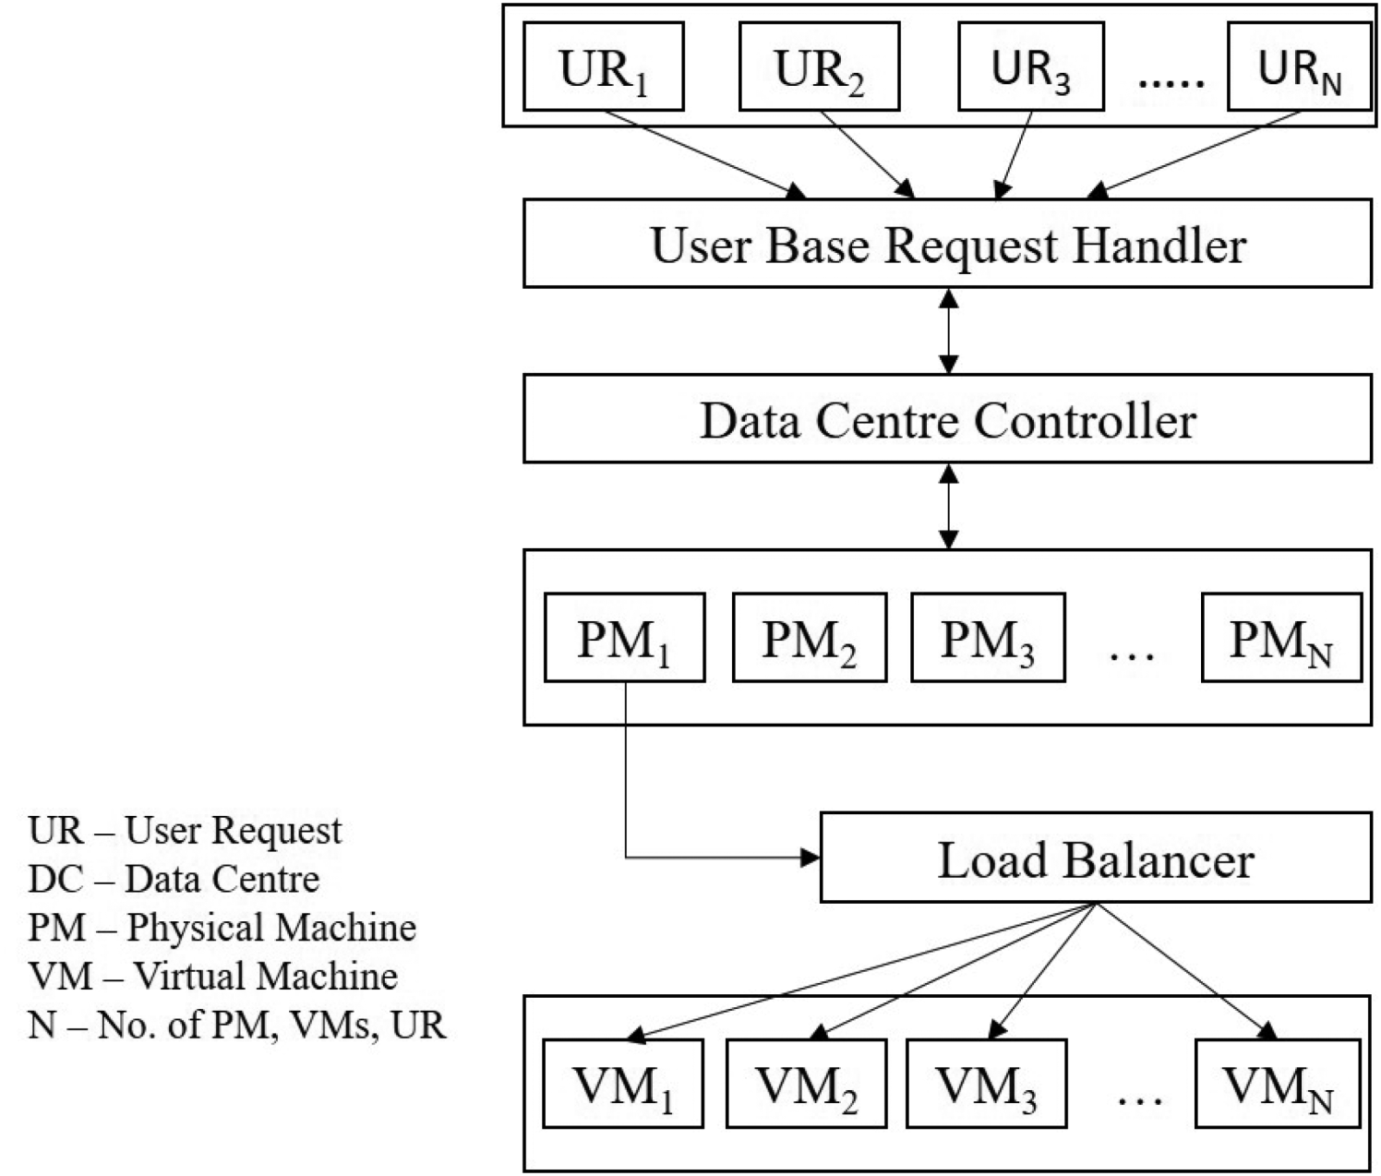
Model for Load Balancing

Slide 6
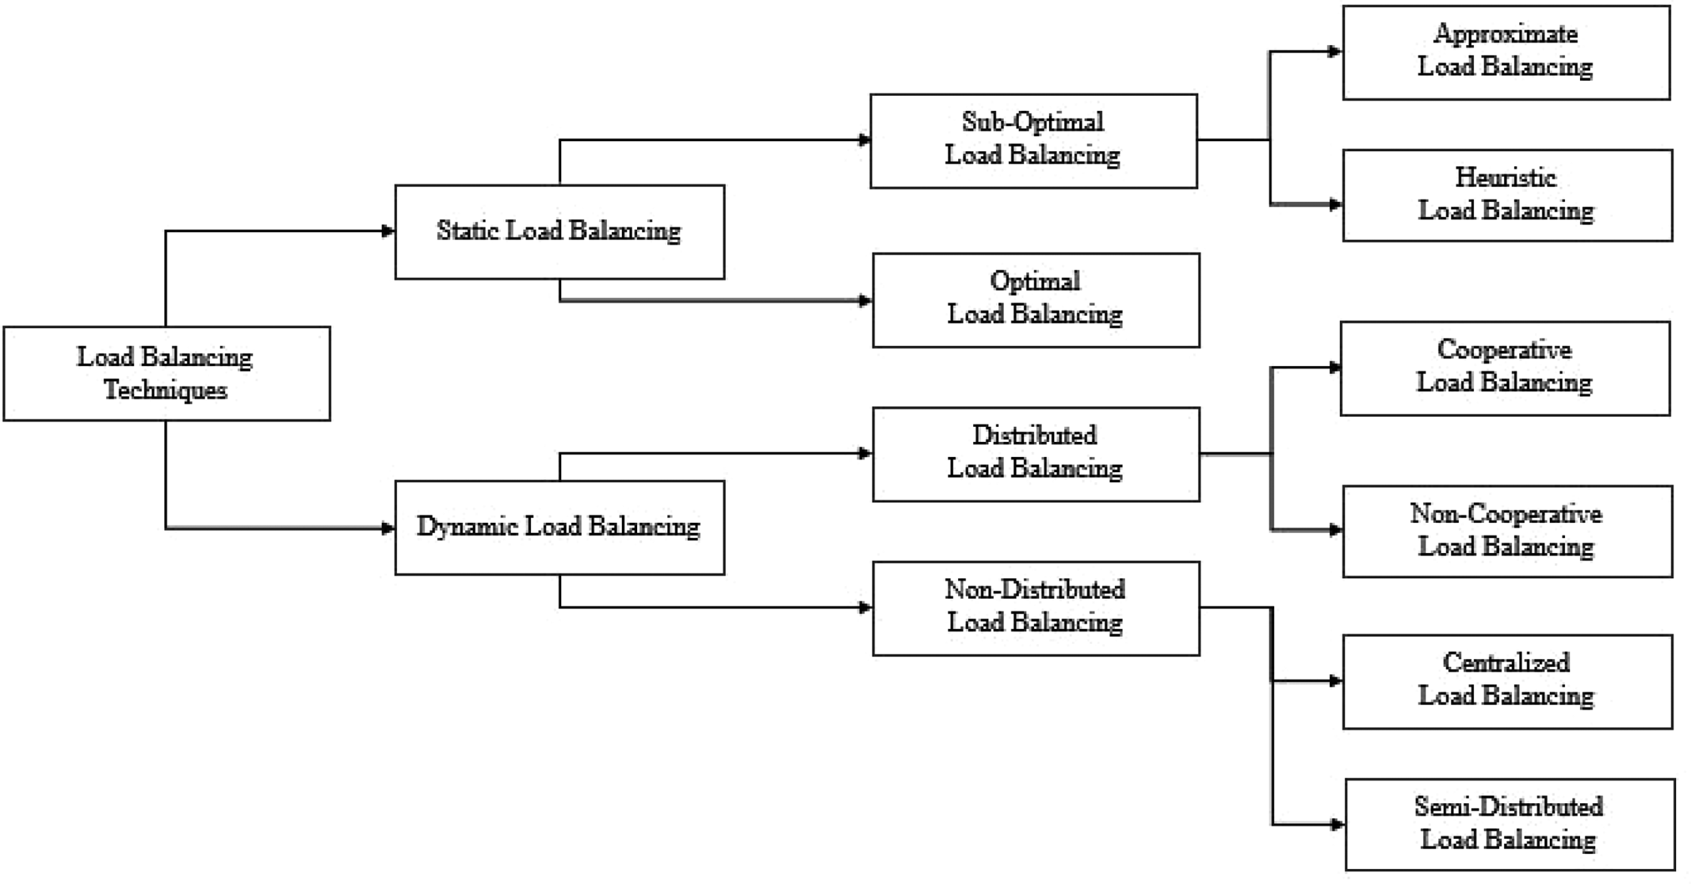
Classification of load-balancing Algorithms

Slide 7
Static Load-Balancing Techniques
Static load-balancing techniques do not need knowledge of the current state of a system; they keep only knowledge of system resources such as execution time, memory, storage capacity, and processing power of nodes in advance.
Static load balancing does not allow allocation of resources at execution time.
These techniques are easy to implement and execute but are useful for smaller system or networks with a smaller number of resources.
Because they do not consider the current state of the system, these techniques are not useful for computing systems performing distributed computing.
They also do not allow detection of the connected server machine at execution time, which leads to uneven distribution of resources.

Slide 8
Dynamic Load-Balancing Techniques
Static techniques do not need knowledge of the current state of the system because these techniques are unsuitable for distributed computing systems that change state dynamically and need the current state of resources at a time interval.
Thus, we require dynamic load-balancing techniques that are suitable for the cloud environment.
Vary load during the execution of the processes.
All previous factors are taken into account by making the division of load dependent upon the execution of the parts as they are being executed.
Does incur an additional overhead during execution, but it is much more effective than static load balancing

